Slide 1
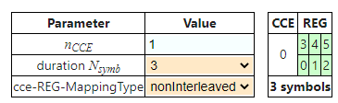
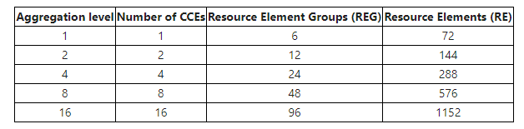
PDCCH MAPPPING
CCE value 1 with Duration Symbols 3
Mapping type only NonInterleaved.
Interleaved not applicable

Slide 2
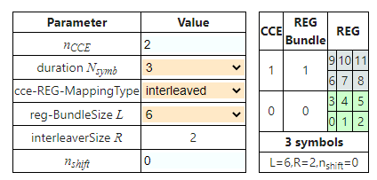
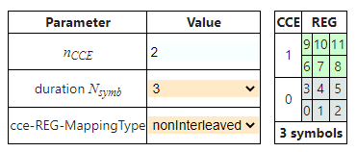
PDCCH MAPPPING
Interleaved
Non-Interleaved
CCE value 2 with Duration Symbols 3

Slide 3
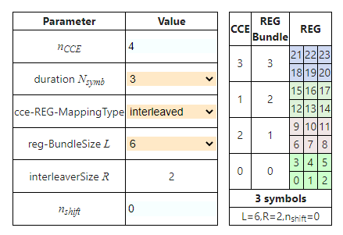
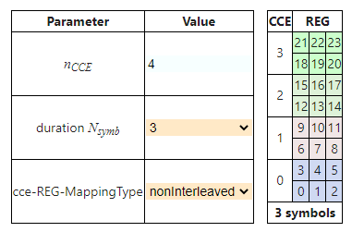
PDCCH MAPPPING
Interleaved
Non-Interleaved
Non-Interleaved
CCE value 4 with Duration Symbols 3

Slide 4
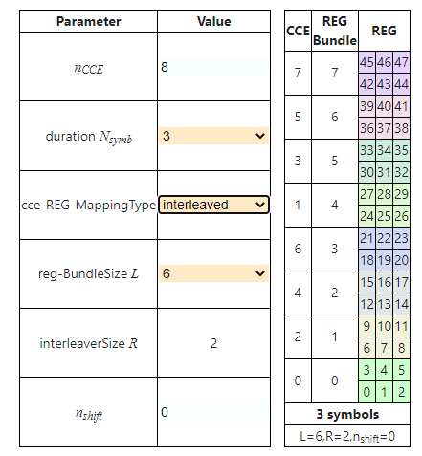
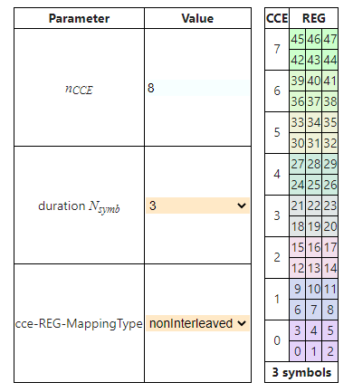
PDCCH MAPPPING
Interleaved
Non-Interleaved
CCE value 8 with Duration Symbols 3

Slide 5
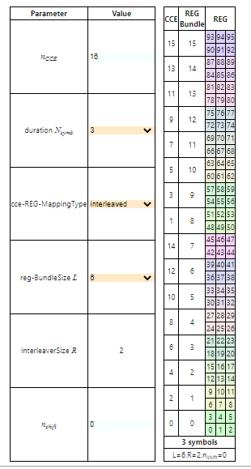
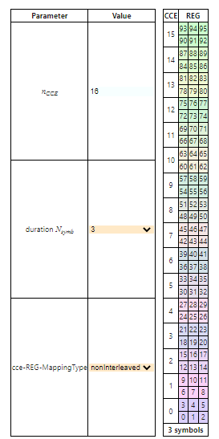
PDCCH MAPPPING
Interleaved
Non-Interleaved
CCE value 16 with Duration Symbols 3

